Slide 1
Dynamic Programming
(Intermediate)
Sharif Minhazul Islam Emon

Slide 2
Digit DP
Description: A technique used to count numbers in a range [L, R] that satisfy a certain property based on their digits. The problem is usually solved by calculating the count up to R and subtracting the count up to L-1.
Resources:
GeeksforGeeks - Digit DP Introduction
Codeforces - Digit DP Tutorial

Slide 3
Digit DP
How it Works (States):
index: The current digit position we are considering.
tight (or limit): A bool flag indicating whether we are currently constrained by the digits of the upper bound (e.g., R).
is_started (or leading_zeros): A boolean flag indicating whether we have placed any non-zero digit yet.
Other State Variables: These are specific to the problem's property. For example:
sum: If the problem involves the sum of digits.
remainder: If the problem involves divisibility by a certain number.
last_digit: If the property depends on adjacent digits.
count_digits: If we need to count occurrences of a specific digit.

Slide 4
Practice Problem
SPOJ - CPCRC1C - Sum of Digits
Problem Statement: Given two non-negative integers a and b, where a <= b. The problem is to find the sum of digits of all numbers x such that a <= x <= b.
Constraints: 1 <= a <= b <= 10^9

Slide 5
Practice Problem
Codeforces - 55D - Beautiful numbers
Problem Statement: A number is considered beautiful if it is divisible by each of its non-zero digits. Find the number of beautiful numbers in the range [l, r].
Input: The first line of the input contains an integer t (1 ≤ t ≤ 10), the number of test cases. Each of the next t lines contains two integers l and r (1 ≤ l ≤ r ≤ 9·10^18).

Slide 6
Practice Problem
Codeforces - 55D - Beautiful numbers
Solution:
Utilize dynamic programming with state parameters including number length, divisibility flag, remainder of division by LCM of digits, and a mask of used digits.

Slide 7
Practice Problem
Codeforces - 55D - Beautiful numbers
Solution:
Utilize dynamic programming with state parameters including number length, divisibility flag, remainder of division by LCM of digits, and a mask of used digits.
Reduce state space by leveraging number theory, specifically maintain the lcm of digits, not the mask, to decrease the number of values.

Slide 8
Practice Problem
Codeforces - 55D - Beautiful numbers
Solution:
Utilize dynamic programming with state parameters including number length, divisibility flag, remainder of division by LCM of digits, and a mask of used digits.
Reduce state space by leveraging number theory, specifically maintain the lcm of digits, not the mask, to decrease the number of values.
Number theory optimization reduces running time by eliminating transitions to digits 5 and 2.

Slide 9
Practice Problem
AtCoder - Educational DP Contest - K - Digit Sum
Problem Statement: Find the number of integers between 1 and K (inclusive) such that the sum of their digits is a multiple of D.
Input: The input consists of two integers K (1 ≤ K < 10^10000) and D (1 ≤ D ≤ 100).
Output: Print the count modulo 10^9 + 7.

Slide 10
String + DP
Description: DP problems where the state involves substrings or subsequences of one or more strings. Classic examples include Longest Common Subsequence (LCS) and Edit Distance.
Resources:
Longest Common Subsequence (LCS) - GeeksforGeeks
GeeksforGeeks - Edit Distance
ডাইনামিক প্রোগ্রামিং ৪ (লংগেস্ট কমন সাবসিকোয়েন্স) | শাফায়েতের ব্লগ

Slide 11
Practice Problem
AtCoder - Educational DP Contest - F - LCS
Problem Statement: Given two strings s and t, find one longest common subsequence of s and t.
Input: The first line contains string s, and the second line contains string t. (1 ≤ |s|, |t| ≤ 3000).
Output: Print one of the longest common subsequences.

Slide 12
Practice Problem
AtCoder - Educational DP Contest - F - LCS
Problem Statement: Given two strings s and t, find one longest common subsequence of s and t.
S = "xabcd"
T = "yazc"

Slide 13
Practice Problem
CSES - Edit Distance
Problem Statement: The edit distance between two strings is the minimum number of operations required to transform one string into the other. The allowed operations are: adding a character, removing a character, and modifying a character.
Input: The first line has a string of length n, and the second line has a string of length m. (1 ≤ n, m ≤ 5000).
Output: Print one integer: the edit distance between the strings.

Slide 14
Practice Problem
CSES - Edit Distance
DP States?

Slide 15
Practice Problem
Longest Palindromic Substring
Problem Statement: Given a string S, find the length of the longest substring inside S which is also a palindrome.

Slide 16
Tree DP
Description: DP on trees, where subproblems are defined on the subtrees of a node. A DFS traversal is typically used to compute the DP states from children to parent.
Resources:
Codeforces - Tree DP Tutorial
TopCoder - Dynamic Programming on Trees
মিনিমাম ভারটেক্স কভার প্রবলেম | শাফায়েতের ব্লগ

Slide 17
Practice Problem
Type 1
Problem Statement: You are given a tree where each node is either white or black. Now for each of the node u, you have to find the number of white nodes in the subtree of u.

Slide 18
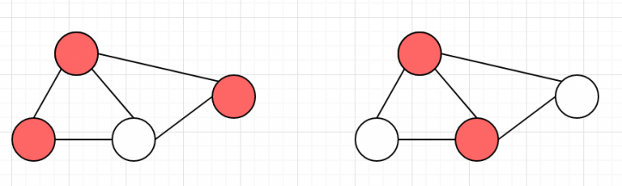
Practice Problem
Type 2
Problem Statement: Minimum vertex cover problem. You will be given a tree. You need to find the minimum number of vertex to turn light on such that, each of the edges in the tree is connected with at least one lighted vertex.

Slide 19
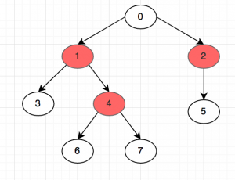
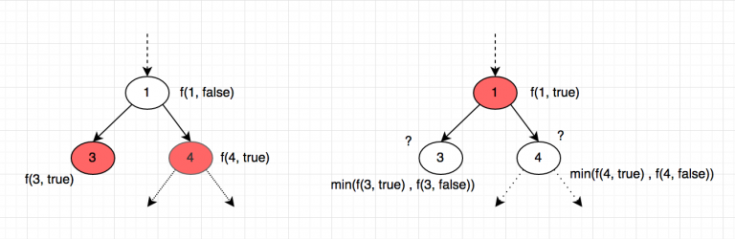
Practice Problem
Type 2

Slide 20
Practice Problem
LightOJ - 1257 - Farthest Nodes in a Tree (II)
Problem Statement: You are given a tree with weighted edges. For each node, find the distance to the farthest node from it.

Slide 21
Practice Problem
LightOJ - 1257 - Farthest Nodes in a Tree (II)
Solution Idea: This requires two DFS traversals.
First DFS (post-order): For each node u, compute down[u]
Second DFS (pre-order): For each node u, compute up[u]. The value of up[v] for a child v depends on up[u] of its parent u and the down paths of its siblings. The final answer for each node u is max(down[u], up[u]).

Slide 22
Matrix Chain Multiplication (MCM)
Description: A DP paradigm where the optimal solution for an interval [i, j] is derived from the optimal solutions of its sub-intervals.
Resources:
GeeksforGeeks - Matrix Chain Multiplication
ডাইনামিক প্রোগ্রামিং ৭ (ম‍্যাট্রিক্স চেইন মাল্টিপ্লিকেশন) | শাফায়েতের ব্লগ

Slide 23
Practice Problem
To calculate the result of a range (u-v), partition it at x and then merge the result of range (u-x) and (x-v). Of course we can partition at all the available x between u and v. We will select the optimal one among them.
A1: (10 x 100) A2: (100 x 5) A3: (5 x 50)
(A1 x A2) x A3 =
A1 x (A2 x A3) =

Slide 24
Basic Game DP
Description: Applying DP to solve impartial games. The state usually represents a game position, and the value is whether it's a winning or losing position. A state is winning if there's a move to a losing state; otherwise, it's losing.
Resources:
CP-Algorithms - Games on arbitrary graphs
GeeksforGeeks - Game Theory and Grundy Numbers
অ্যালগরিদম গেম থিওরি - ১ - শাফায়েতের ব্লগ

Slide 25
Practice Problem
AtCoder - Educational DP Contest - K - Stones
Problem Statement: There is a heap of K stones. Two players, Taro and Jiro, take turns playing a game. In each turn, a player chooses a number a_i from a given set A and removes a_i stones from the heap. The player who cannot make a move loses. Determine the winner assuming optimal play.
Input: Two integers N and K. The second line contains N distinct positive integers a_1, a_2, ..., a_N.
Output: Print "First" if the first player (Taro) wins, otherwise print "Second".

Slide 26
Practice Problem
Solution Idea:
Define dp[i] to represent whether having i stones is a winning position.
A position i is winning if there exists a move a in set A such that the resulting position i-a is a losing position.
Compute dp[i] from i=0 to K, with dp[0] initialized to false. For each i, check all possible moves a in A and set dp[i] to the logical OR of !dp[i-a] for all a in A.

Slide 27
Thank You

